Slide 1
The key areas we work in

Slide 2
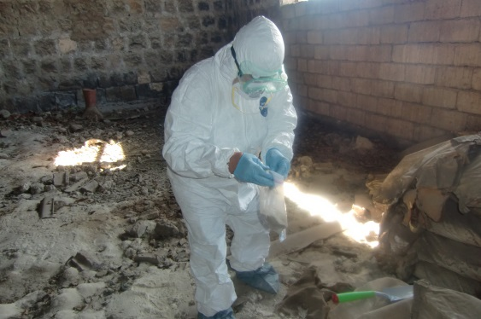
Chemicals
Member of the Steering Committee of the NIP for the Stockholm Convention on POPs in Armenia
NGO Focal Point for the Stockholm and Minamata Conventions, and SAICM process, IPEN member
Assessment and feasibility studies of the Obsolete Pesticides (OP) burial site in Nubarashen
Long term collaboration with MoNP, MES and Academy of Science (Center for Ecological- Noosphere studies) related to burial site

Slide 3
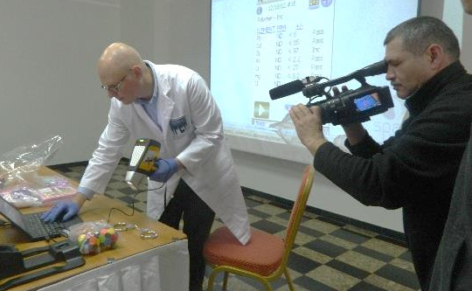
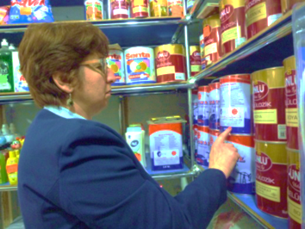
Chemicals
Initiation of Public Hearing in Brussels (joint efforts with IHPA and OSCE on burial site problem) in 2011. Successful collaboration with OSCE
Inventory and community-based monitoring of storages of obsolete pesticides jointly with the Ministry of Agriculture
National advocacy campaigns against heavy metals, lead in paint and phthalates in toys
Assessment of pollution and contamination of the environment of Akhtala, Alaverdi and Teghut communities jointly with ECOLUR NGO and Czech ARNIKA NGO

Slide 4
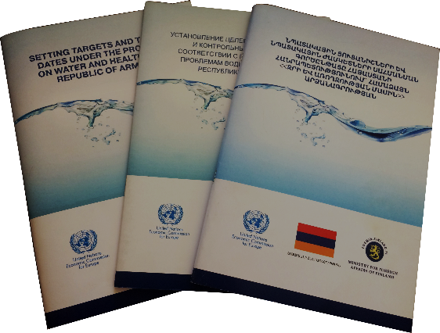
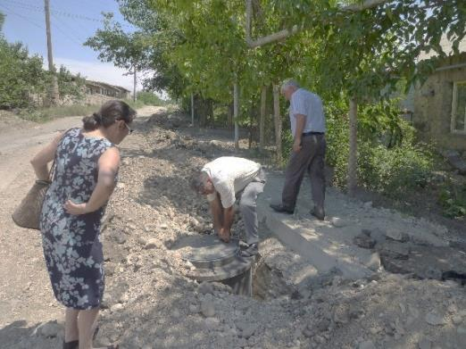
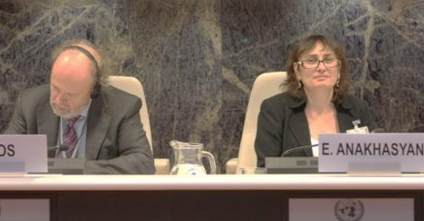
Water & Sanitation
Projects related to UNECE/WHO Protocol on Water and Health
Participation in decision making processes via National Policy Dialogue
Provision of drinking water to communities
Construction of ecological sanitation facilities for schools and households
Cleaning of water drainage systems
Raising awareness and education campaigns on safe drinking water, adequate sanitation and hygiene
Sharing good practices of Armenia at the international events

Slide 5
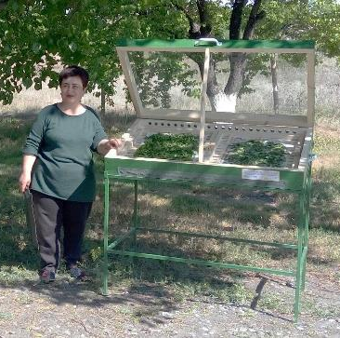
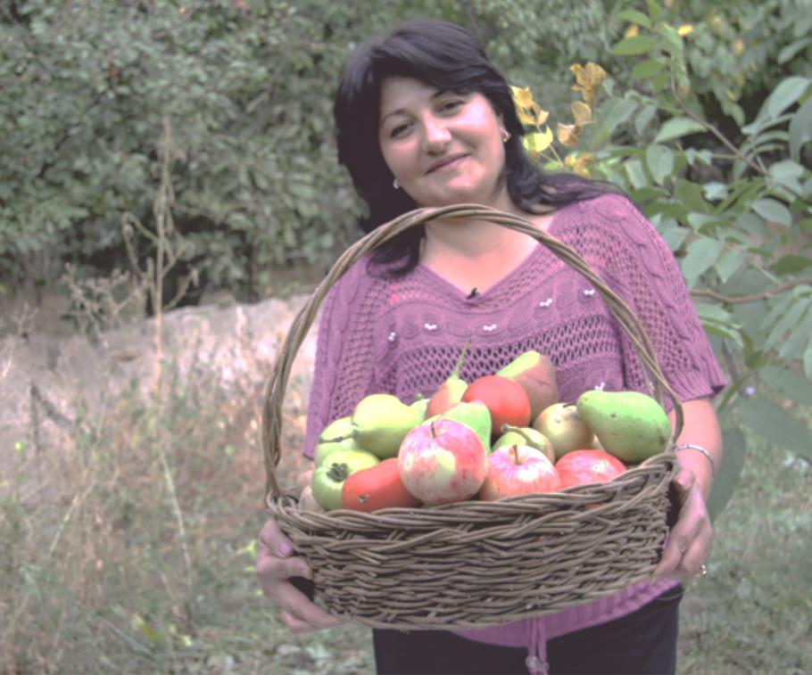
Agriculture
Establishment of small scale vermicomposting and biohumus production
Installment of solar driers for household drying of fruits, herbs and vegetables
Raised awareness on sustainable, organic, pesticide free agriculture

Slide 6
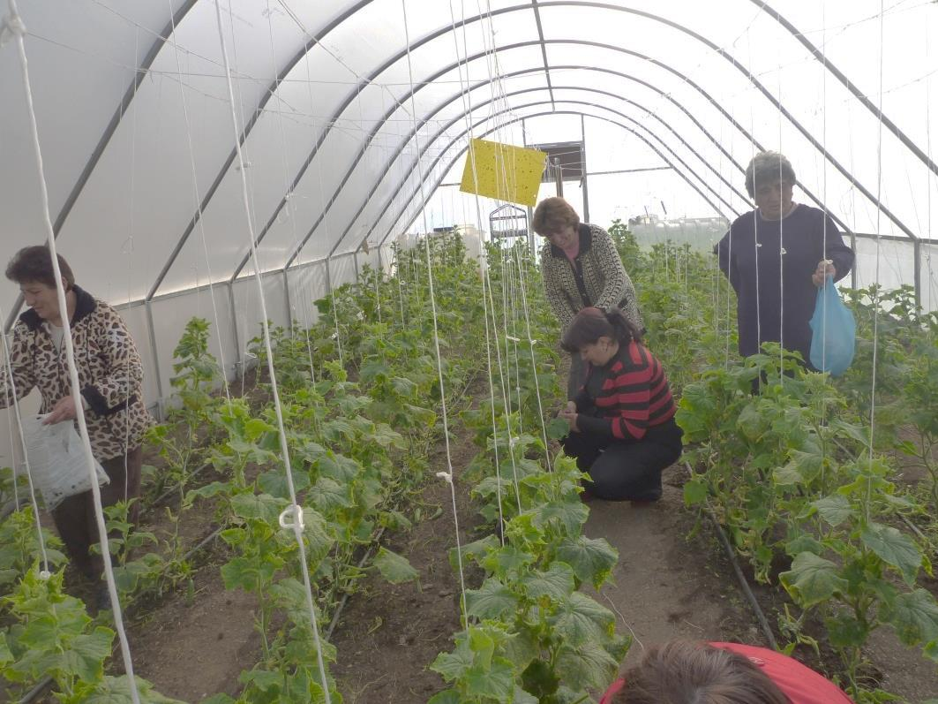
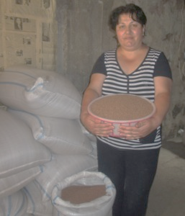
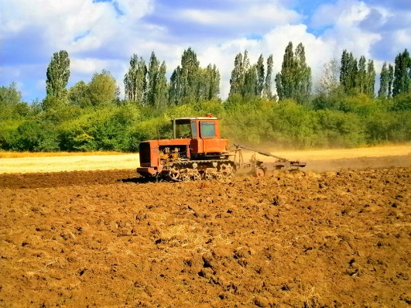
Agriculture
Establishment of Resource Center for sustainable agriculture in Solak village
Rain water harvesting and drip irrigation systems at Solak
Increased capacity of rural women on marketing and sale of locally produced products. Opening and managing a shop in Abovyan city

Slide 7
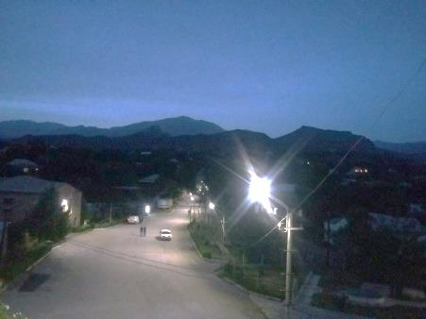
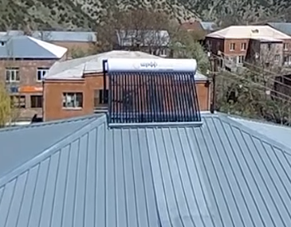
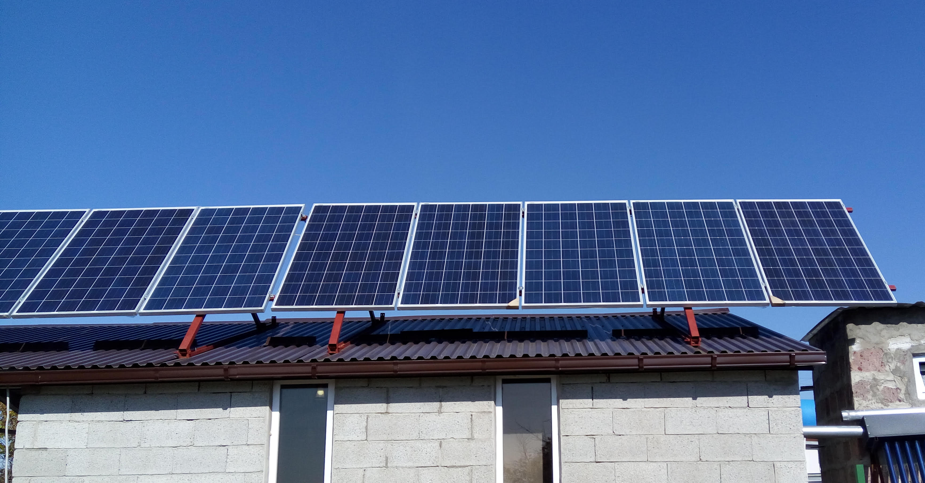
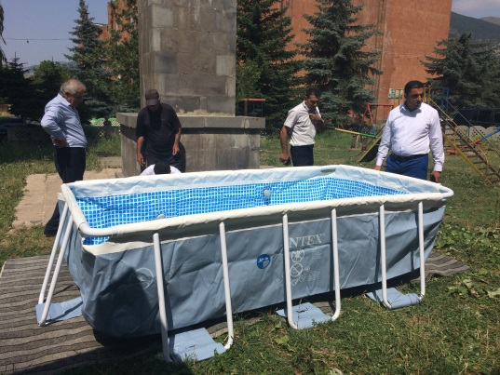
Provision of solar dryers to households for drying
fruits, vegetables and herbs
Installation of a solar water heater in Solak community
Installation of photovoltaic panels to provide street
lighting in Malishka community
Cultivation of crops (lentil) that are resilient to
climate change
Climate change and renewable energy

Slide 8
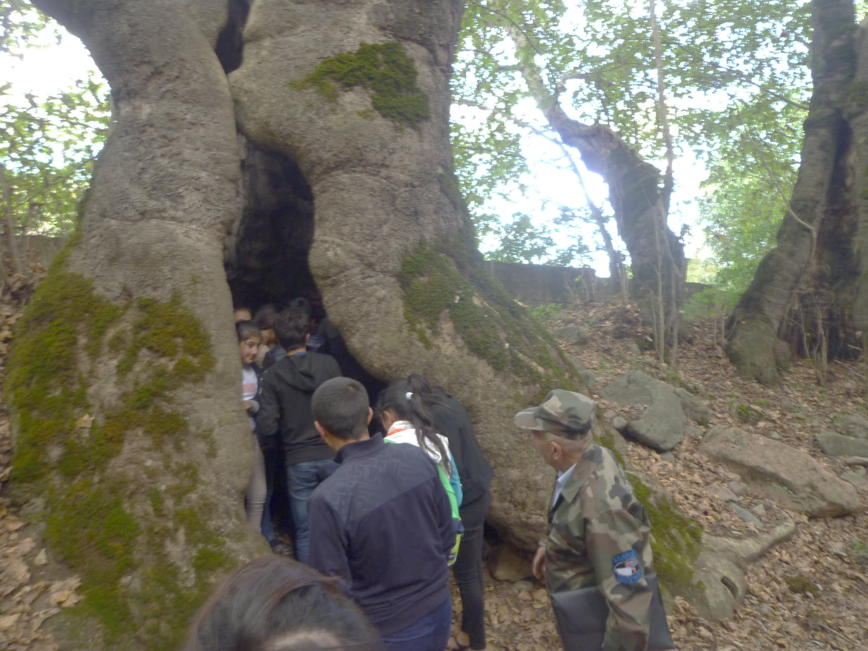
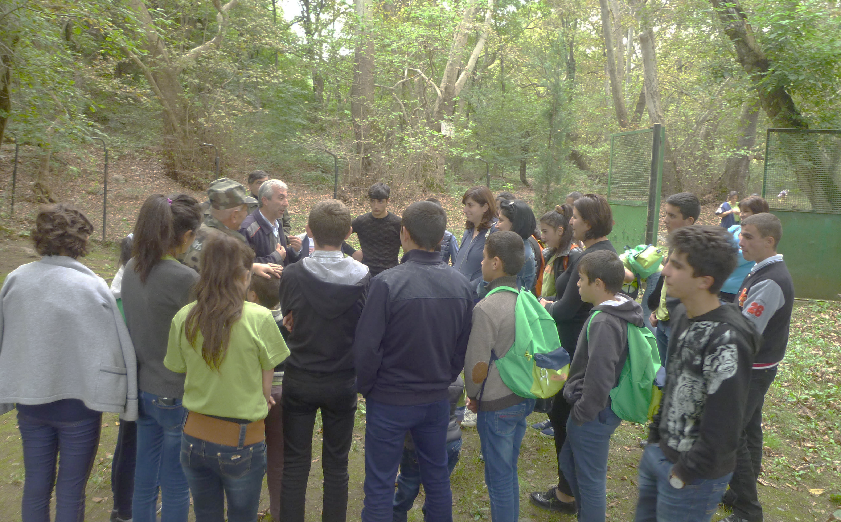
Education
Education of schoolchildren on
water and health
biodiversity
hygiene and sanitation
forests
solar energy
waste
lead in paint
phthalates in toys

Slide 9
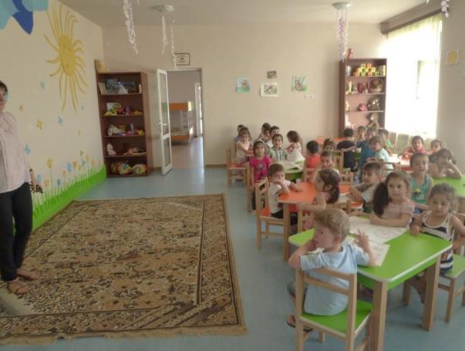
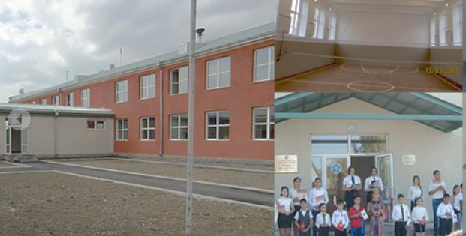
Education
Active member of Environmental education network (EEN) in Armenia
Renovation of the school in Ditak village
Construction of a kindergarten in Ditak village

Slide 10
Thank you! For more information you are welcome to visit our website! www.awhhe.am

